Slide 1
EDA of ‘product a’
Module 2
By: Kevin patel

Slide 2
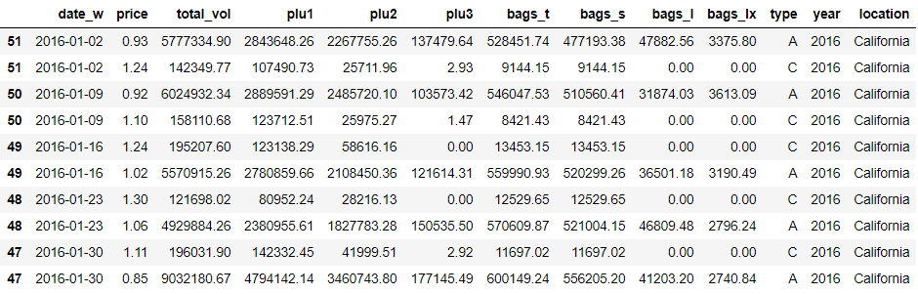
The Data
The data is recorded on Saturdays (end of week) every week for each location
For each location, there are two records per week – one for each product ‘type’

Slide 3
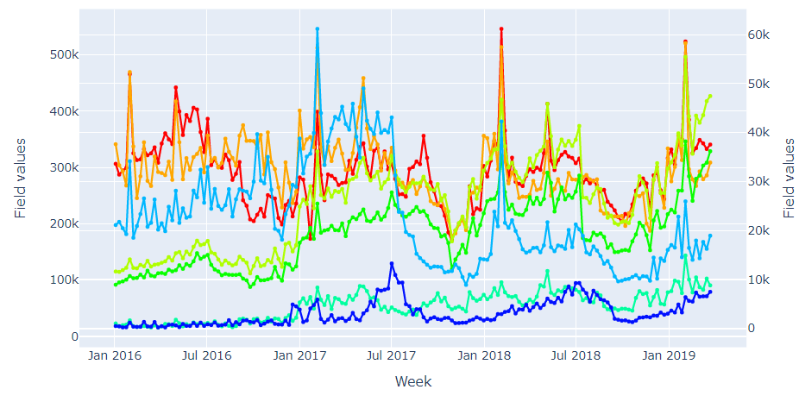
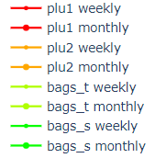
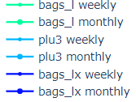
Weekly Graph
Regular spikes observed in all fields in the first week of February every year

Slide 4
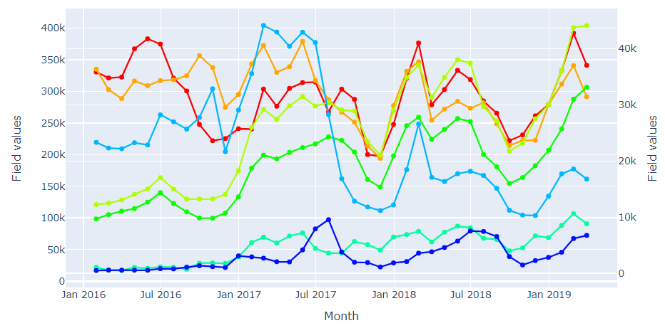
Monthly Graph
A complete cycle comprising of upward and downward trends can be observed

Slide 5
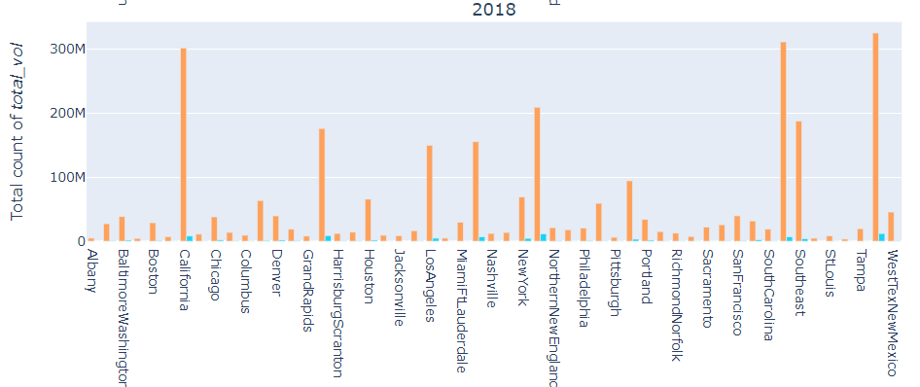
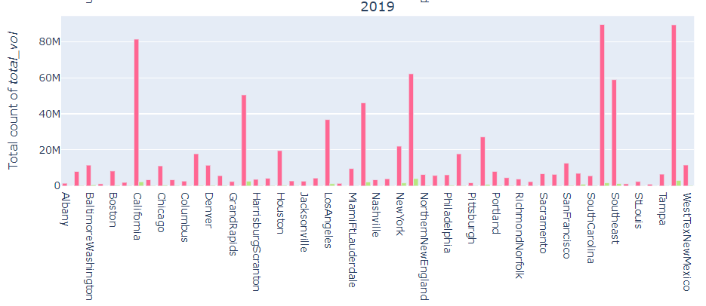
Total volume per locations
‘total_vol’ follows a similar pattern from 2016 to 2018 and no comments can be made for 2019 as only quarterly data is available

Slide 6
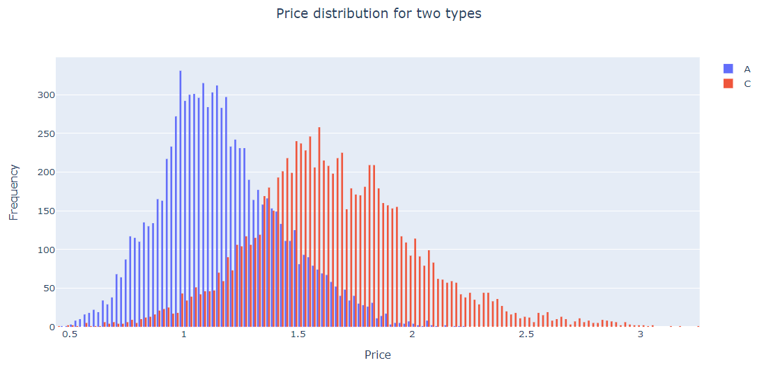
Price per product types
Product type ‘C’ is typically expensive than type ‘A’!

Slide 7
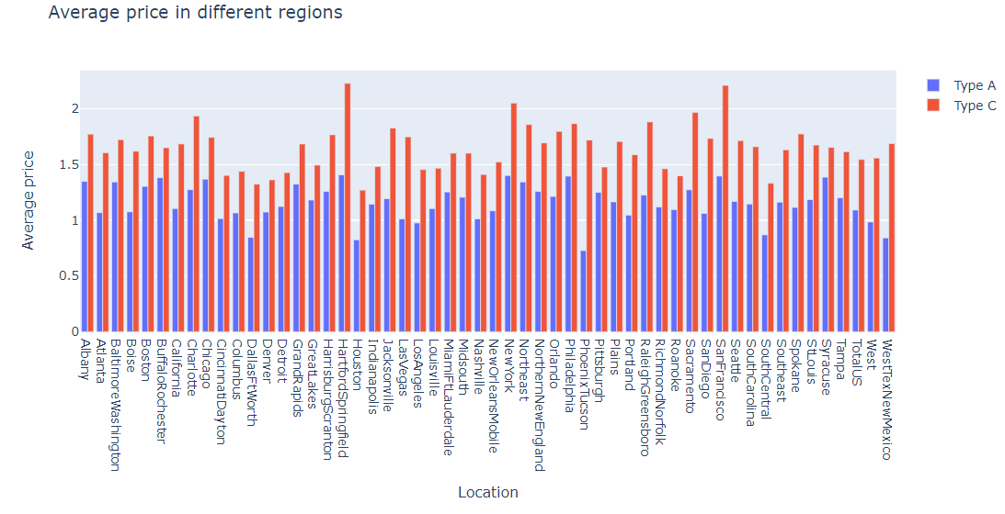
Price per type and location
Product type ‘C’ is still expensive in every US location compared to type ‘A’

Slide 8
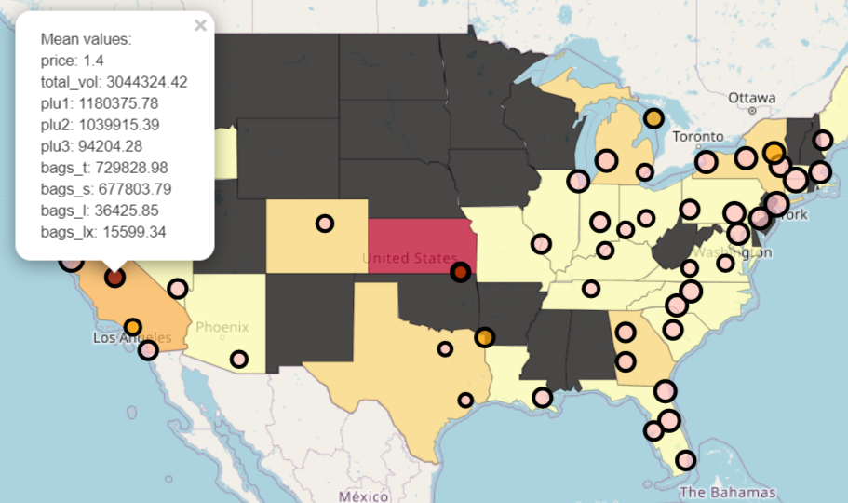
US Map
‘bags_t’ is color coded using ‘Pink’ (min) -> ‘Orange’ (medium) -> ‘Red’ (max)
Radius of locations represents the average price of type ‘A’ product

Slide 9
Thank You

